Slide 1


Numerical Investigation of Wave Packet Spreading Angles in Hypersonic Boundary Layers
Kaden Steiner
Dr. Christoph Hader
Arizona NASA Space Grant Student Research Symposium
Scottsdale, AZ
April 18, 2026

Slide 2
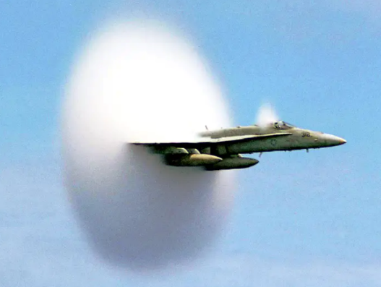
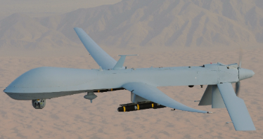
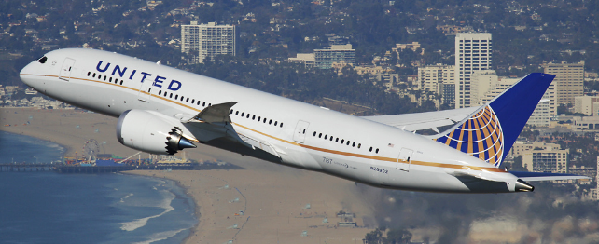
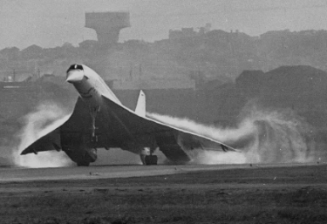
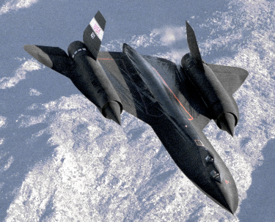
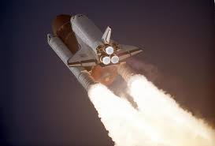
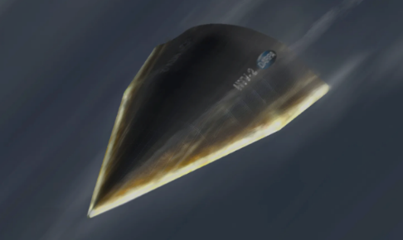
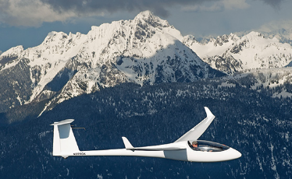
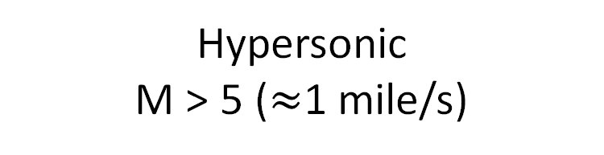
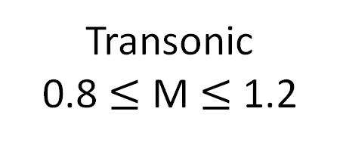

What is Hypersonics?
M = 1
“Sound barrier”
Mach # = ratio of flow velocity to speed of sound (M = U$∞$/c $∞$)
Subsonic
M < 1
Transonic
0.8 $≤$ M $≤$ 1.2
Supersonic
1 < M < 5
Hypersonic
M > 5 ($≈$1 mile/s)
1
Notes:
A boundary layer is the thin region of fluid next to a surface where viscous effects are significant, causing the velocity to change rapidly from zero at the wall (no-slip) to the free-stream value away from it (velocity gradient)
Mention my Emmons model code and how varying parameters changes transition location
Transition: inside boundary layer, flow gains energy and small disturbances grow, causing transition from smooth laminar flow, to unsteady turbulent flow
Emmons Model: transition occurs by the formation of turbulent spots on a surface -> they grow as they propagate in downstream direction -> combine with other spots to form fully turbulent region.

Slide 3
What is a Boundary Layer?
Fluid flows along object surface (freestream)
Further out fewer collisions are affected by surface
Molecules above surface are slowed down due to collisions with molecules sticking to surface (viscosity)
~ 1 – 5 mm tall
Molecules stick to surface
Notes:
A boundary layer is the thin region of fluid next to a surface where viscous effects are significant, causing the velocity to change rapidly from zero at the wall (no-slip) to the free-stream value away from it (velocity gradient)
Mention my Emmons model code and how varying parameters changes transition location
Transition: inside boundary layer, flow gains energy and small disturbances grow, causing transition from smooth laminar flow, to unsteady turbulent flow
Emmons Model: transition occurs by the formation of turbulent spots on a surface -> they grow as they propagate in downstream direction -> combine with other spots to form fully turbulent region.

Slide 4
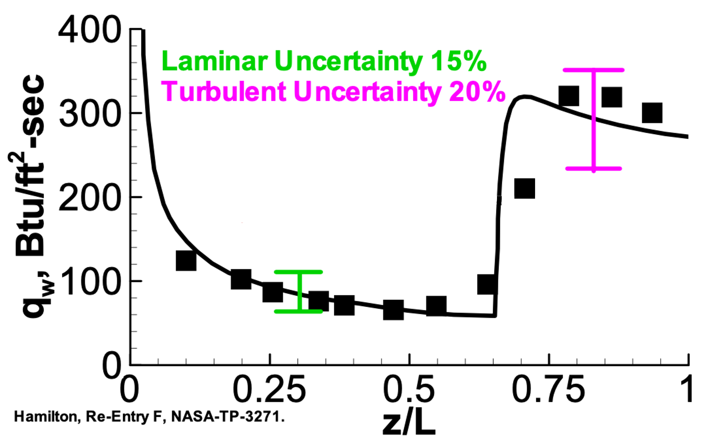
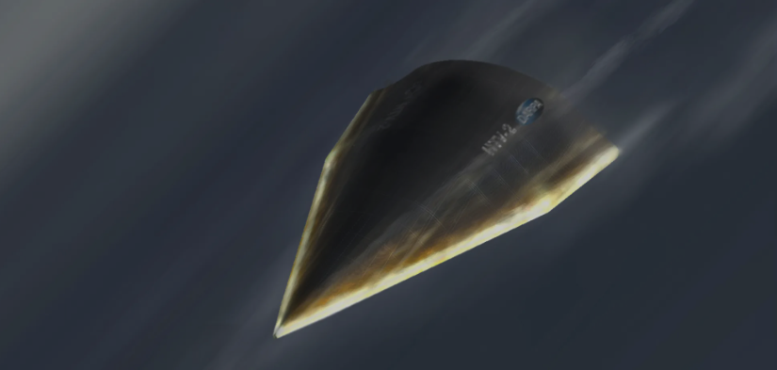
What is Boundary Layer Transition?
Significant increase in skin-friction and heat transfer in turbulent flow
Major impact on vehicle design and performance
  (Thermal protection, aerodynamic drag, control authority)
z
L
(Schneider 2004)
Notes:
A boundary layer is the thin region of fluid next to a surface where viscous effects are significant, causing the velocity to change rapidly from zero at the wall (no-slip) to the free-stream value away from it (velocity gradient)
Mention my Emmons model code and how varying parameters changes transition location
Transition: inside boundary layer, flow gains energy and small disturbances grow, causing transition from smooth laminar flow, to unsteady turbulent flow
Emmons Model: transition occurs by the formation of turbulent spots on a surface -> they grow as they propagate in downstream direction -> combine with other spots to form fully turbulent region.

Slide 5
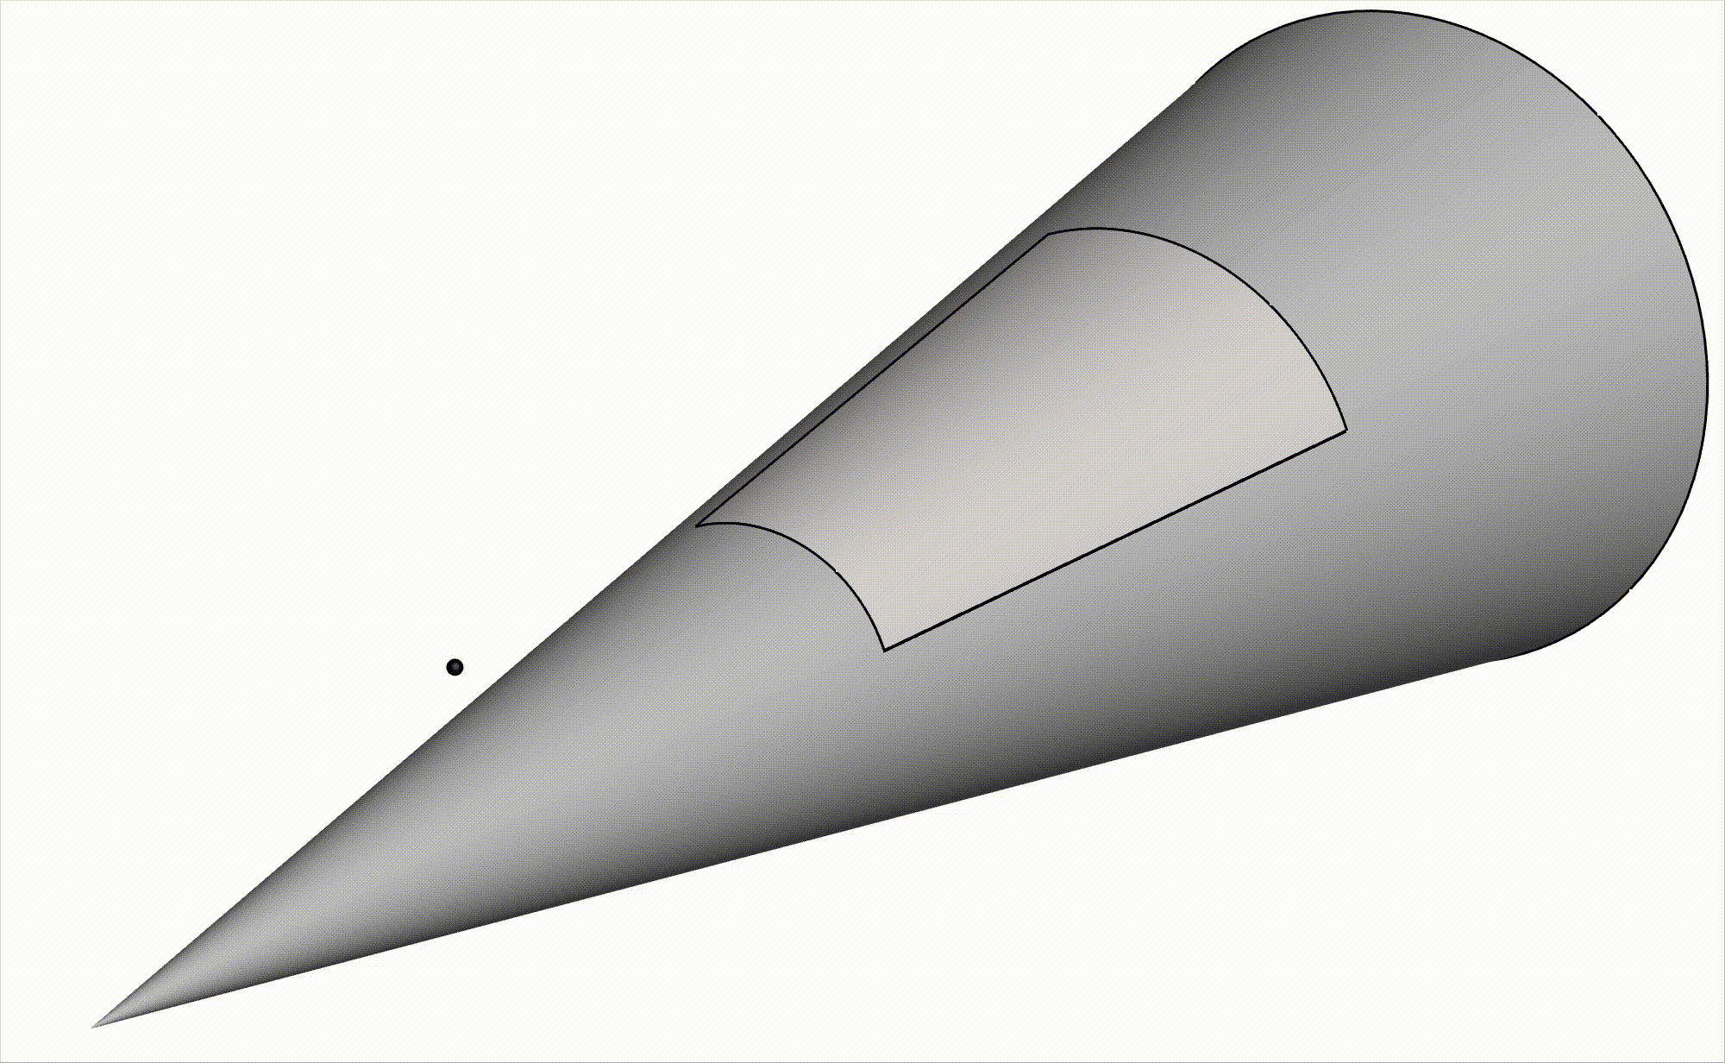
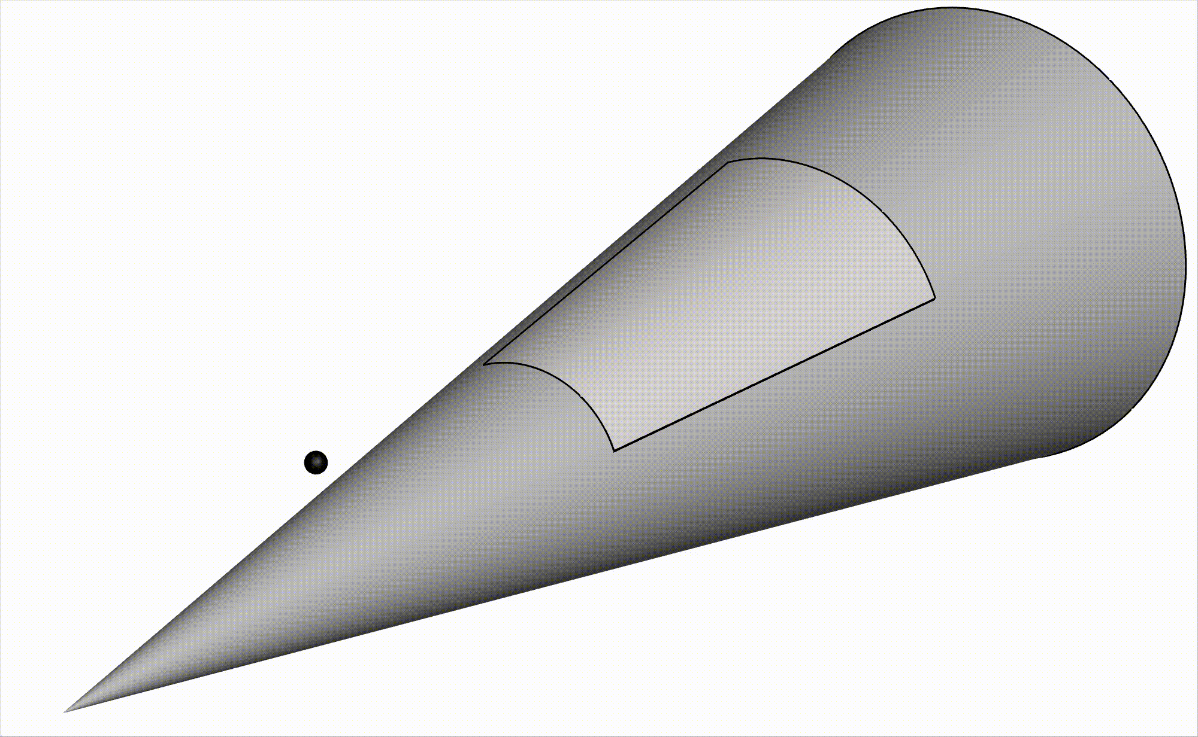
What are Wave Packets?
During flight particles impinge on surface
Wave packet forms
Wave packets evolve into turbulent spots => transition
L
z
*particles not simulated - only for illustration purposes
Notes:
A boundary layer is the thin region of fluid next to a surface where viscous effects are significant, causing the velocity to change rapidly from zero at the wall (no-slip) to the free-stream value away from it (velocity gradient)
Mention my Emmons model code and how varying parameters changes transition location
Transition: inside boundary layer, flow gains energy and small disturbances grow, causing transition from smooth laminar flow, to unsteady turbulent flow
Emmons Model: transition occurs by the formation of turbulent spots on a surface -> they grow as they propagate in downstream direction -> combine with other spots to form fully turbulent region.

Slide 6
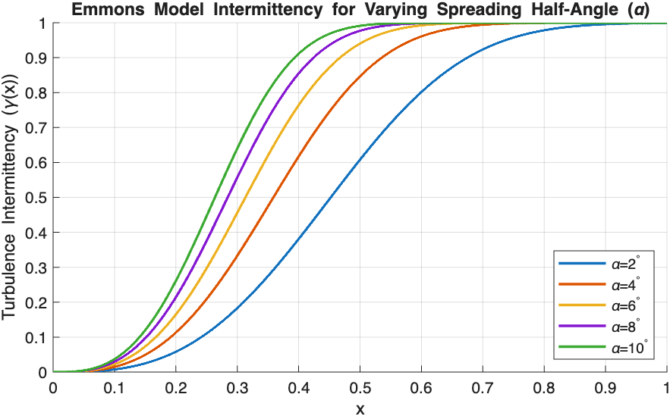
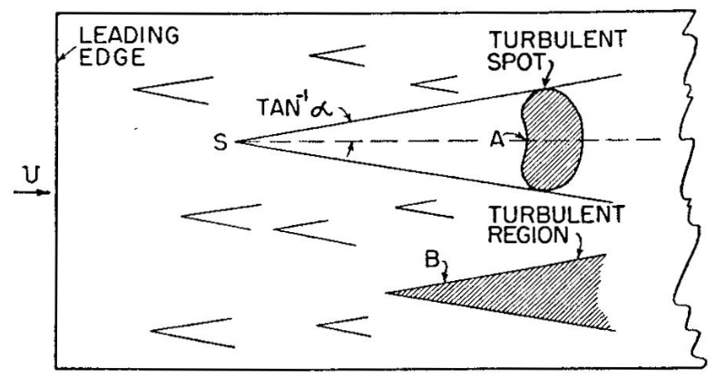
Objectives
Determine spreading angles of wave packets/turbulent spots for various Mach numbers and using simulations
  Never been done before, not feasible with experimental data
Improved hypersonic transition prediction model
(Emmons 1951)
5

Slide 7
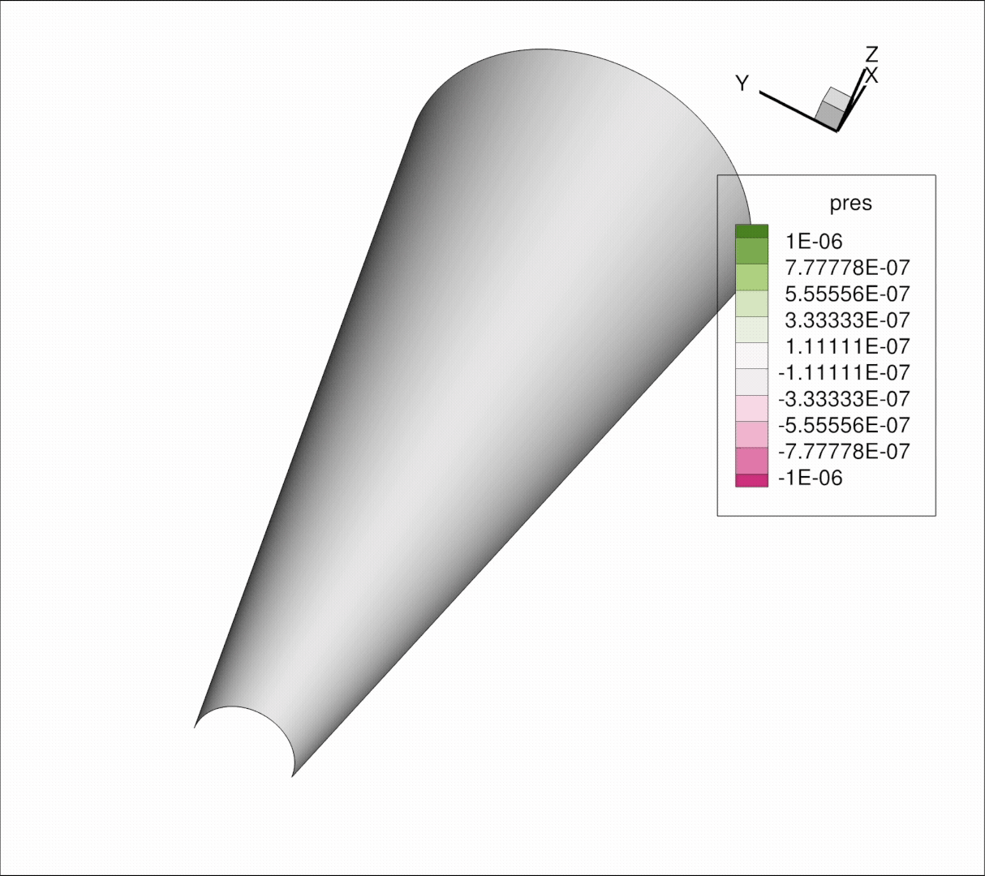
Wave Packet Propagation
Track wave packet as it propagates along the surface
Increase forcing amplitude to obtain linear and nonlinear spreading angles
Final runs to obtain spreading angles for various Mach numbers are currently underway
6

Slide 8
Conclusions and Future Work
Larger spreading angles move transition onset upstream
Connection between Mach number/wall temperature ratio and spreading angle
Continued future work investigating nonlinear spreading angles
7

Slide 9


Acknowledgements
NASA Arizona Space Grant Consortium
Dr. Christoph Hader, David Connors, all other lab members
8

Slide 10
Thank you!

Slide 11
References
Emmons, H. W., "The Laminar-Turbulent Transition in a Boundary Layer — Part I," Journal of the Aeronautical Sciences, Vol. 18, No. 7, 1951, pp. 490–498.
Schneider, S., “Hypersonic laminar–turbulent transition on circular cones and scramjet forebodies,” Progress in Aerospace Sciences, Vol. 40, No. 1, 2004, pp. 1–50.
Disclaimer
The material contained in this document is based upon work supported by a National Aeronautics and Space Administration (NASA) cooperative agreement 80NSSC25M7084. Any opinions, findings, conclusions or recommendations expressed in this material are those of the author and do not necessarily reflect the views of NASA. This work was supported through a NASA grant awarded to the Arizona/NASA Space Grant Consortium.
Notes:
A boundary layer is the thin region of fluid next to a surface where viscous effects are significant, causing the velocity to change rapidly from zero at the wall (no-slip) to the free-stream value away from it (velocity gradient)
Mention my Emmons model code and how varying parameters changes transition location
Transition: inside boundary layer, flow gains energy and small disturbances grow, causing transition from smooth laminar flow, to unsteady turbulent flow
Emmons Model: transition occurs by the formation of turbulent spots on a surface -> they grow as they propagate in downstream direction -> combine with other spots to form fully turbulent region.

